Slide 1
Hiring Process Analytics
Nayan Jain

Slide 2
Project Description
Conducted data analysis on hiring process to uncover insights on gender distribution, average salary trends, salary distribution intervals, departmental composition, and post tier representation.
Employed visualizations, such as charts and graphs, to facilitate comprehensive understanding and deliver actionable recommendations for enhancing the hiring process.
Tech-Stack Used
Excel

Slide 3
Approach
Dataset Understanding: Explored variables including application ID, interview dates, status, event names, departments, post names, and offered salaries.
Data Cleaning with EDA: Conducted EDA techniques to clean and preprocess the data, ensuring its quality and integrity.
Problem and Question Analysis: Examined and comprehended the provided problems and questions for further analysis.
Statistical Analysis and Visualization: Utilized diverse statistical methods and visualization tools to analyze the data and extract meaningful insights.

Slide 4
Checking for Missing Data
Column Name | Missing Data if any
Application_id | No missing data
Interview Taken on | No missing data
Status | No missing data
Event_name | 15 rows where the data is missing
Department | No missing data
Post Name | 1 rows where the data is missing
Offered Salary | 1 rows where the data is missing
Note: As the number of rows with missing values is minimal, we will apply Missing Value Treatment. To exclude these rows from the final sheet and do visualization, we can conveniently utilize Excel's filtering functionality.

Slide 5
Finding Outliers
 |  | Salary |  |  | Salary
 | Min | 800 |  | IQR | 48871
 | q1 | 25516.5
 | Median | 49625 |  |  | Values
 | q3 | 74387.5 |  | Upper bound | 147694
 | Max | 400000 |  | Lower Bound | -72506.5
To ensure a cleaner and more accurate dataset, we will remove rows with Offered salary values that are considered outliers, specifically those above 147,694 and below -72,506.5.
3 outliers in offered salary (200000, 300000, 400000)

Slide 6

Hiring:
1) How many males and females are Hired?

Slide 7
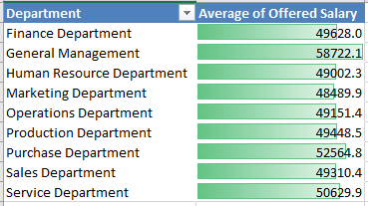
Average Salary:
2) What is the average salary offered in this company?
Total Average Salary – 49983
Highest average salary is of General Management and lowest is of Human Resource Department.

Slide 8
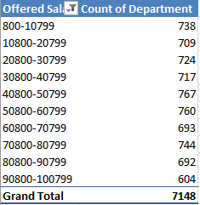
Class Intervals:
3) Draw the class intervals for salary in the company?
To effectively visualize the salaries, The intervals taken of 10,000 to identify the predominant salary range.
The salary distribution appears to be fairly balanced across different classes, indicating a relatively equal distribution of salaries.

Slide 9
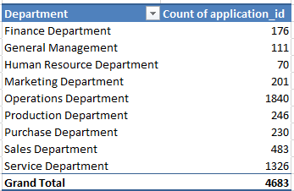
Charts and Plots:
4) Draw Pie Chart / Bar Graph ( or any other graph ) to show proportion of people working different department ?
The Operation Department shows the highest proportion of employees, while the HR Department has the lowest workforce representation.

Slide 10
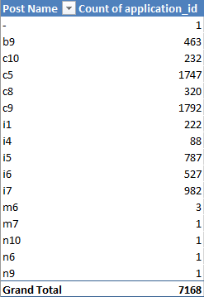
Charts:
5) Represent different post tiers using chart/graph?
C9 and C5 have the maximum count and m7,n10,n6 and n9 have the minimum.

Slide 11
Result and Drive Link
Through this project, I gained practical experience in utilizing Excel for various tasks in a corporate setting. This included hands-on practice in data cleaning, handling outliers, summarizing data, and creating data visualizations.
Specifically, I learned essential techniques such as creating class intervals, utilizing quartiles and the interquartile range (IQR) to identify outliers.
Link: https://docs.google.com/spreadsheets/d/1vmZC0n5_4wdJdQhWq31W1xdLcL06XKqL/edit?usp=sharing&ouid=102725852097216668817&rtpof=true&sd=true

